Slide 1

Cleaning the Data and Analyzing It
Alvaro Hu

Slide 2
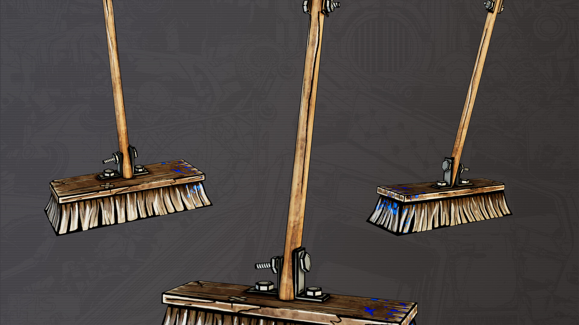
Cleaning the Data
Something went wrong in the data ingestion

Slide 3
Received two files
CSV file
Contains player usage metrics
Many corrupted rows (500,000 out of 1,700,000)
Cleaned in Python and Excel resulting table ~1,500,000 rows
JSON file
Contains 5 hours of player metrics
Split into two tables, 1 for each JSON endpoint
* Data Cleaning steps in Appendix slides 25-28

Slide 4
The Final Data Tables
full_data -> from CSV
Contains each player session, character they used, map, playtime, etc. Essentially usage data
1.7 million rows
Added columns: SESSION_TIME, DAY_NUM
Will help in analysis
sessions -> from JSON
More usage metrics, but these can be joined to the “weapons” table.
Subset of 5 hours of data
~100,000 rows
Added “date” column from Timestamp
weapons -> from JSON
Contains the character, type of weapon, amount and types of damage, etc.
~700,000 rows
Joins to “context” table in one-to-many relationship

Slide 5
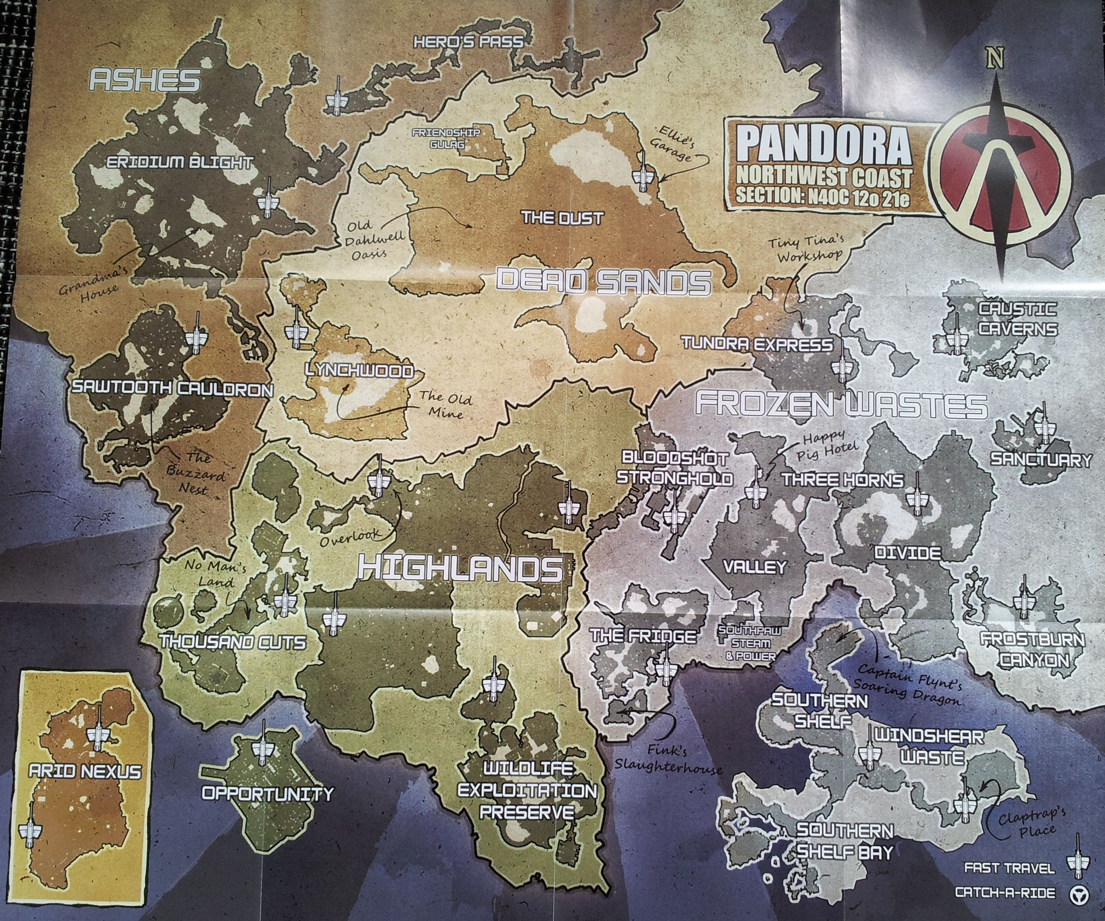
Exploring the Data

Slide 6
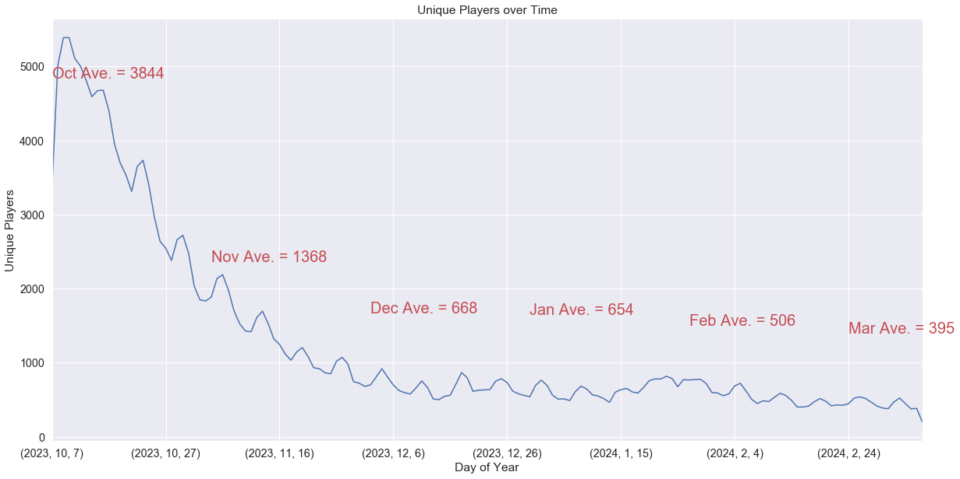
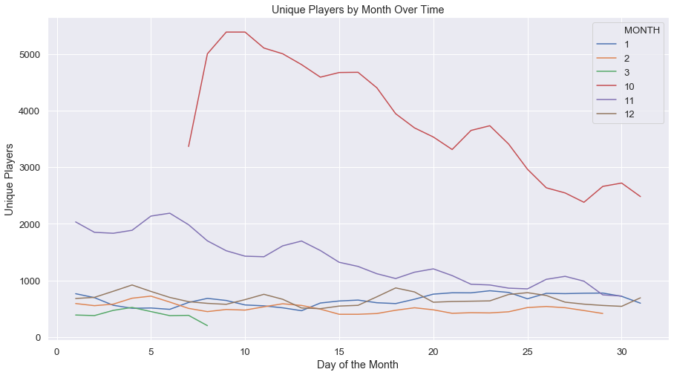
Unique Players per Month
* Analyses in written form in Appendix slide 29

Slide 7
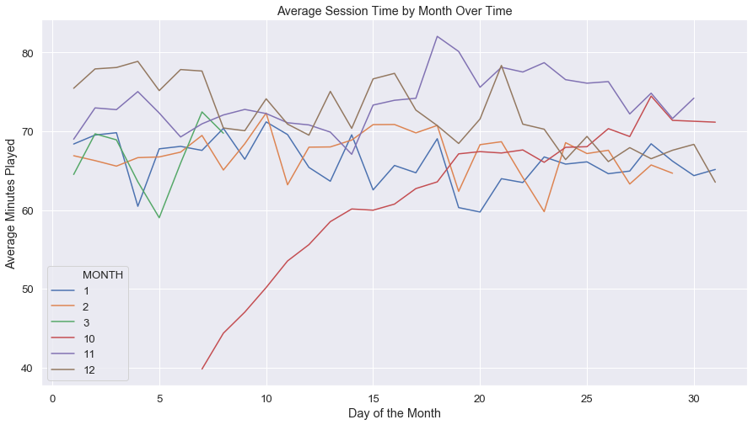
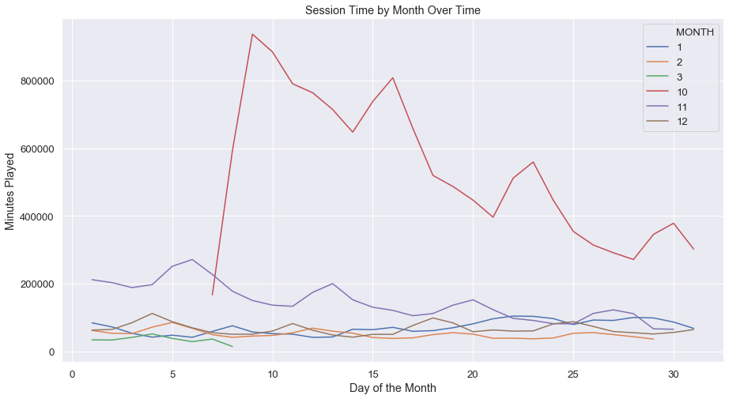
The number of Total minutes played per day also increases on the weekends People’s session times remain more-or-less constant over the months.

Slide 8
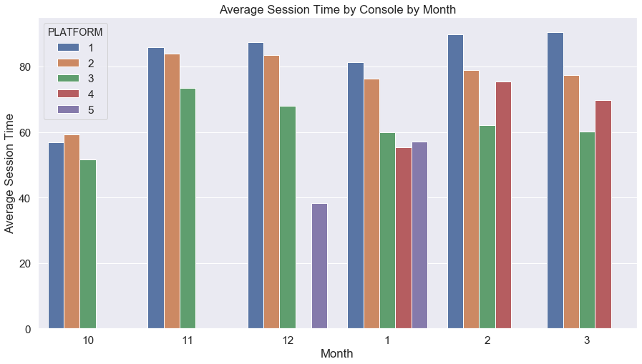
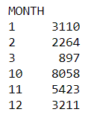
People played it for shorter amount of time in October, but there were more players
Number of Players

Slide 9
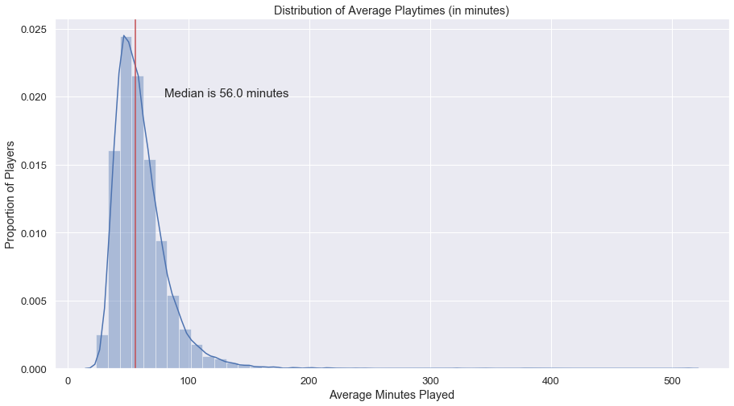
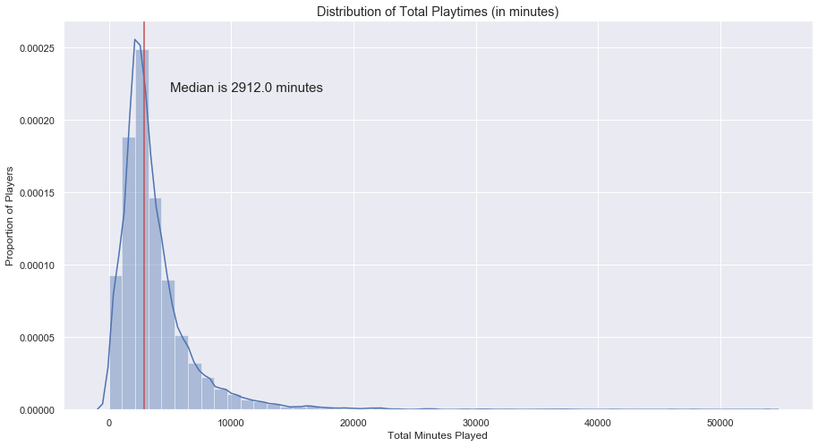
How long are people playing?
Distribution of Average Playtimes (in minutes)
Does it have the “Just one more” component?
* Additional analyses in written form in Appendix slide 30

Slide 10
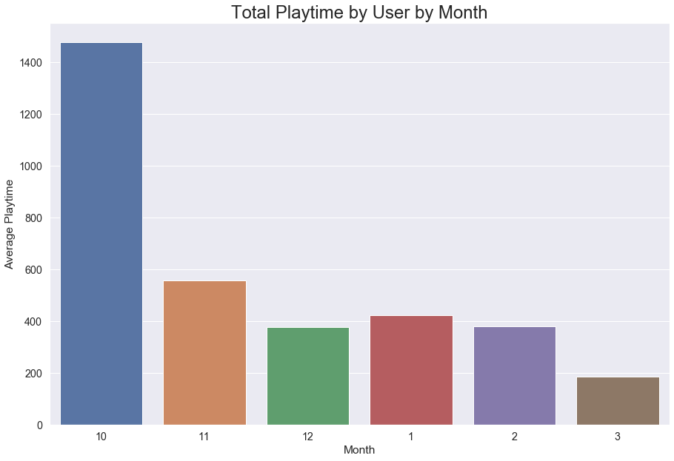
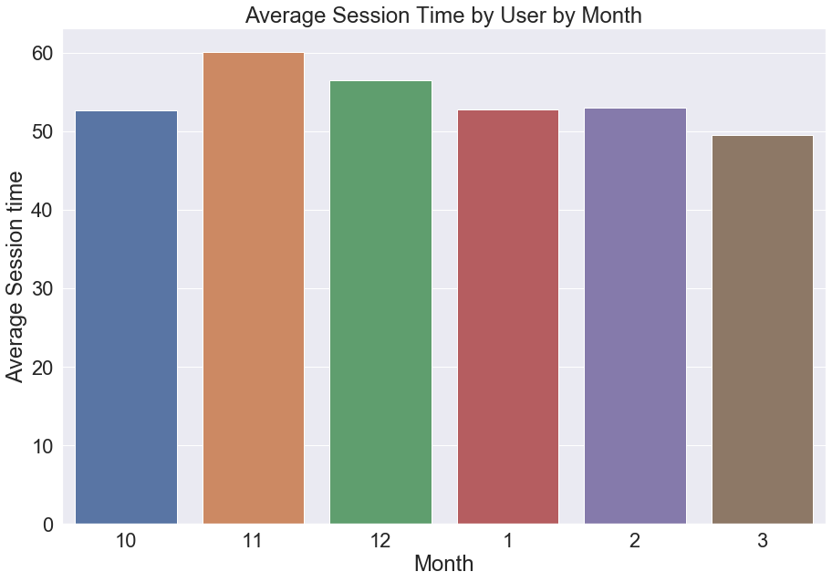
Playtime By Month
Winter break/vacation affecting player behavior?
* Additional analyses in written form in Appendix slide 31

Slide 11

Summary on Playtimes
October (release month) had the most unique players by far
Player count peaks on weekends.
Though less players now, still play for the same time (~1 hour)
For some reason, average playtime was low in October
Possible reasons:
People played more on average in November and December. Thanksgiving and Holiday vacation?
Total amount of time people play is ~3,000 minutes or about 50 hours of gameplay
This makes sense, as Borderlands is an open-world RPG

Slide 12

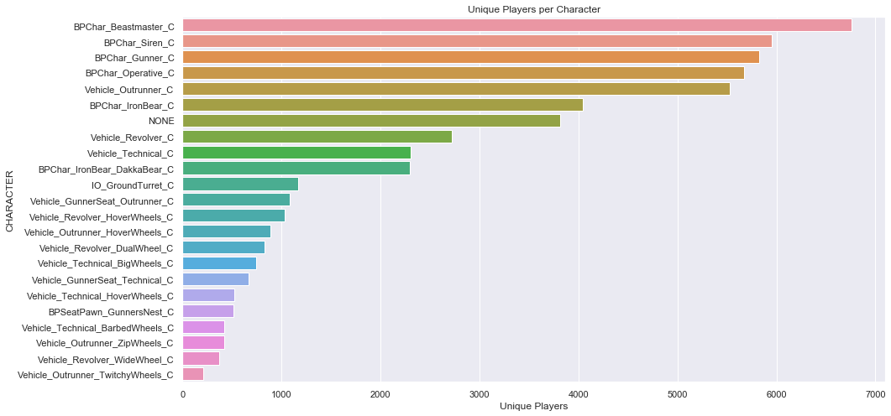
People LOVE Beast Master (FL4K)
Almost 1,000 more Players than the next most
Operative comes last of 4 vault hunters

Slide 13
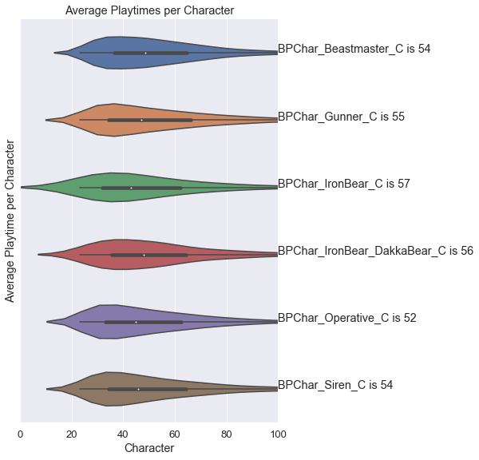
Which Vault Hunter is played for the longest

Slide 14

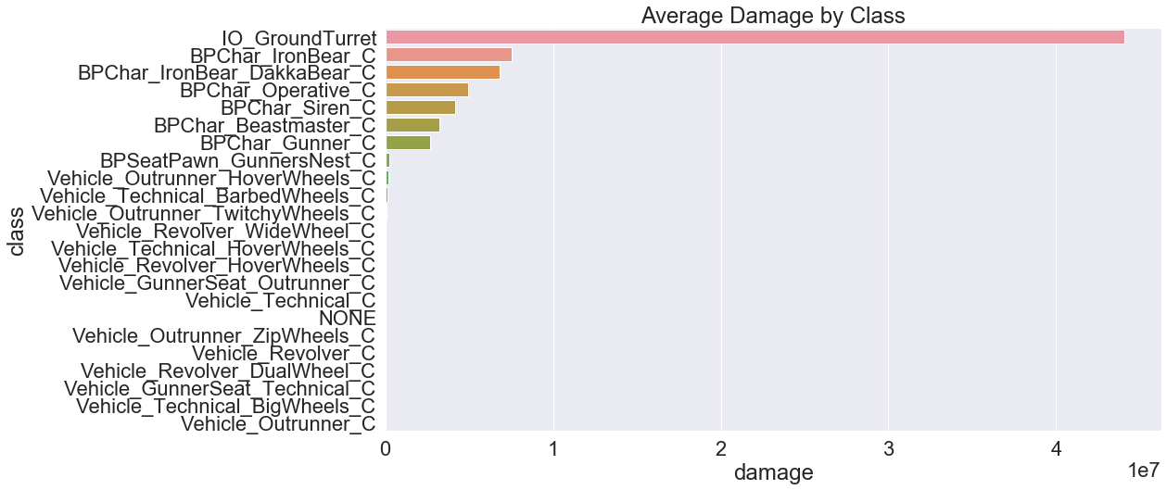
Operative (Zane) does the Most Damage

Slide 15
Summary on Characters
Beastmaster has the highest number of Unique Players
Operative has the lowest
Gunner is played the longest on average, while the Operative is played the shortest
Smaller differences. Can do statistical significance testing to follow up
The Operative does the most damage on average. The Gunner does the least.
Possible that the Operative is difficult to master

Slide 16
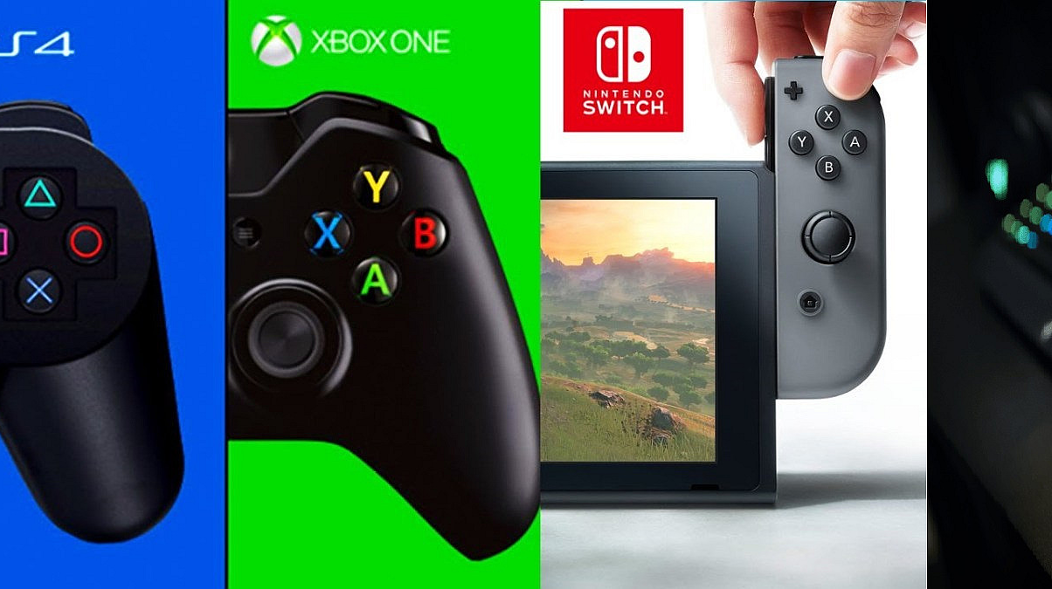
What are people using to play Borderlands 5?

Slide 17
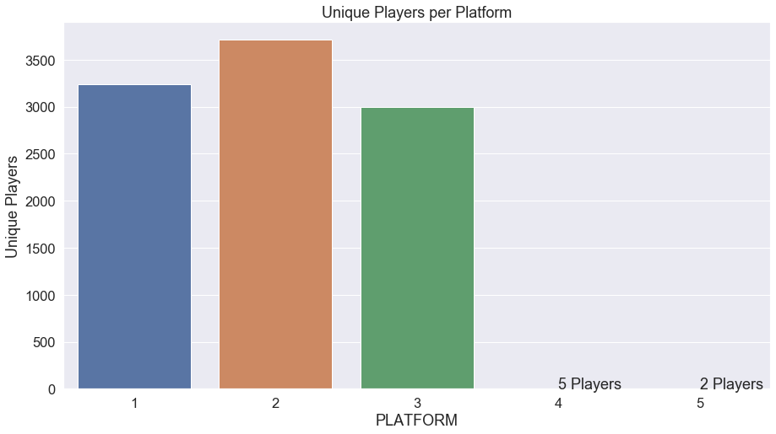
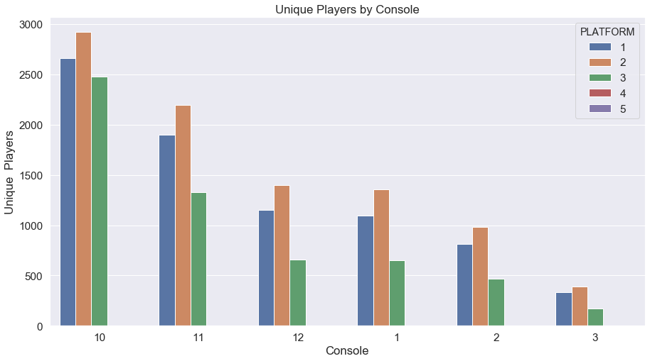
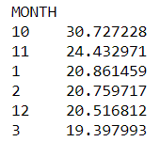
3 Platforms above the rest
Platform 3 starts off very strong, but quickly declines in proportion of users
30% to %20 by January

Slide 18
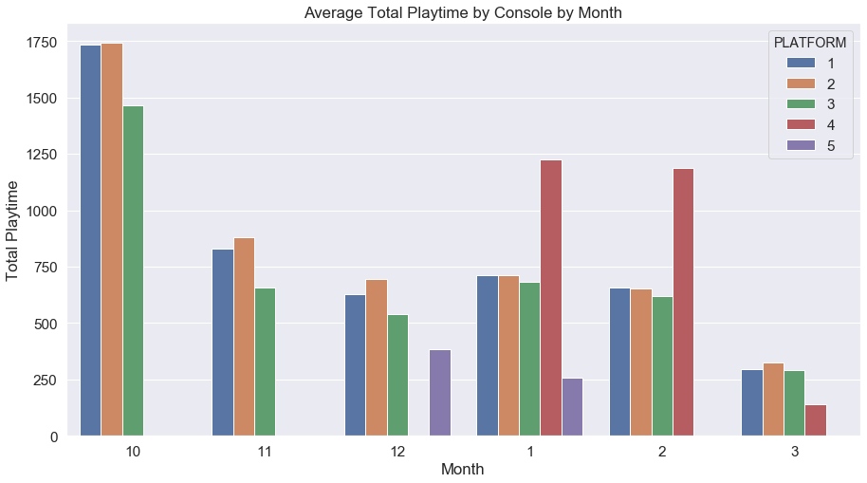
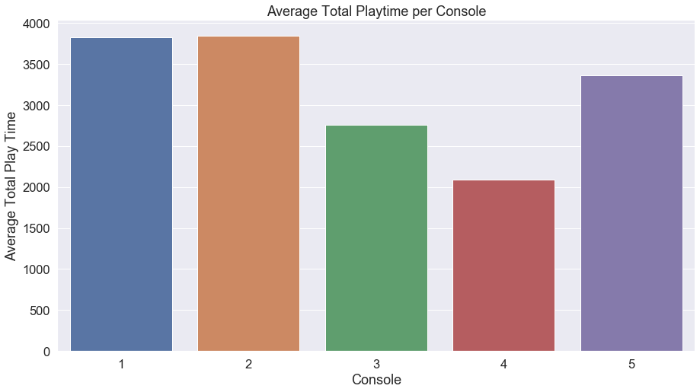
Platform User Behaviors
* Additional analyses in written form in Appendix slide 32

Slide 19
Summary on Platform Habits
Platform 4 (Stadia?) didn’t release until January
Playtimes dropped fast though. Maybe poor experience?
Platform 3 (PC?) started strong in platform-share but decreased in proportion
30% of share to 20%
Platforms 1 and 2 (PS4 and Xbox?) have the strongest playtimes and are roughly equal throughout

Slide 20

Let’s look at a subset of data
Looking at a subset of 5 hours of data

Slide 21
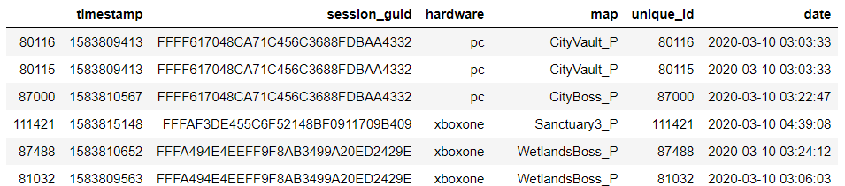
Checking the specifics
Session ID: Can appear more than once
Created to join weapons table
Created from timestamp: 5 hours of data

Slide 22
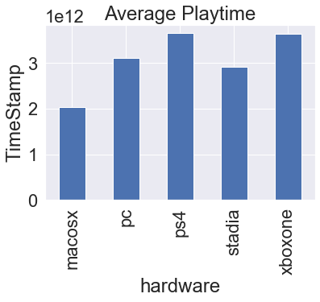
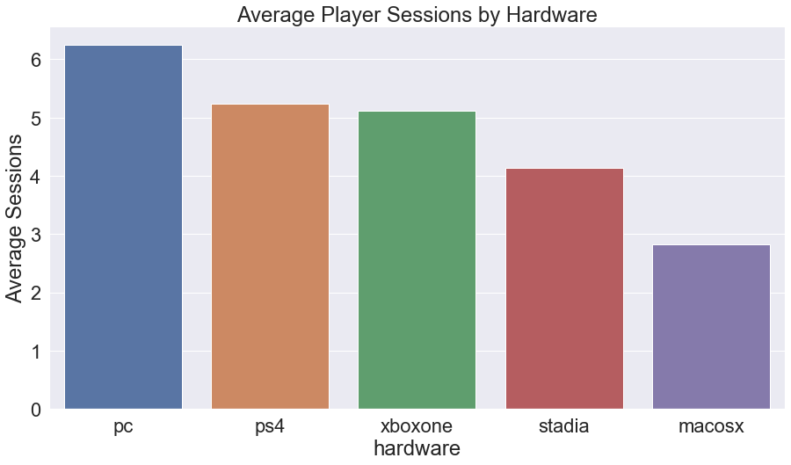
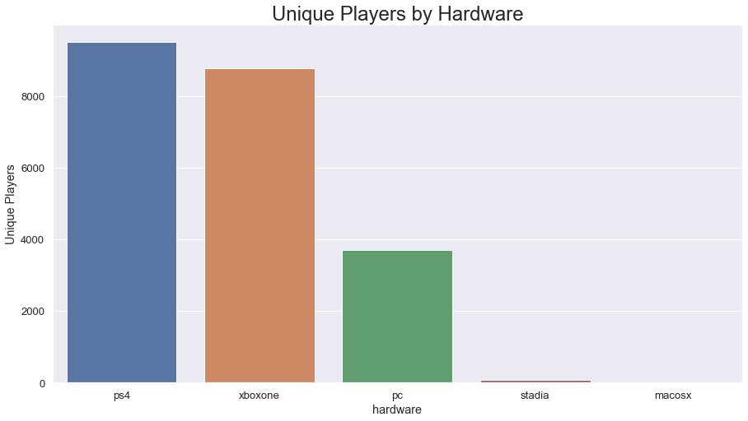
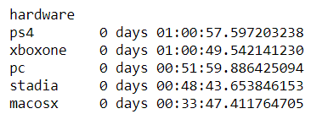
Less PC Players… but they’re better?
* Additional analyses in written form in Appendix slide 33

Slide 23


Final Recommendations
Different playstyles = different marketing approaches
PC players are “better”. Get more done
There are more PS4 and Xbox players
Increase the session time
Competitive games have the “just one more” aspect
Raids and live community events for co-op
The Operative: Powerful, but not played
Could be a high learning curve for this character
Have you tried How-To’s or Official Borderlands Wiki pages to help players understand the different characters?
Player drop-off
“Game as a service” to keep playerbase?
Pros and Cons to this

Slide 24
Appendix
Data Cleaning Steps taken
Additional Analyses for slides

Slide 25
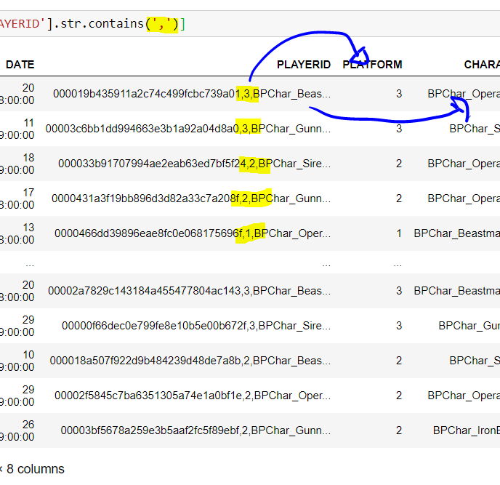
The CSV
1,700,000 rows; 500,000 corrupted
Almost 1/3… can’t drop these
What’s wrong with them?
Data in many columns shifted several cells over
Coincidence?
There were also ~500,000 rows in the “clean” data with extra rows of data within a single cell!
Because of the similarity in numbers, I came to the conclusion that the 500,000 corrupted rows of data were caused because of these rows
Rest of the clean data was ingested into Python

Slide 26
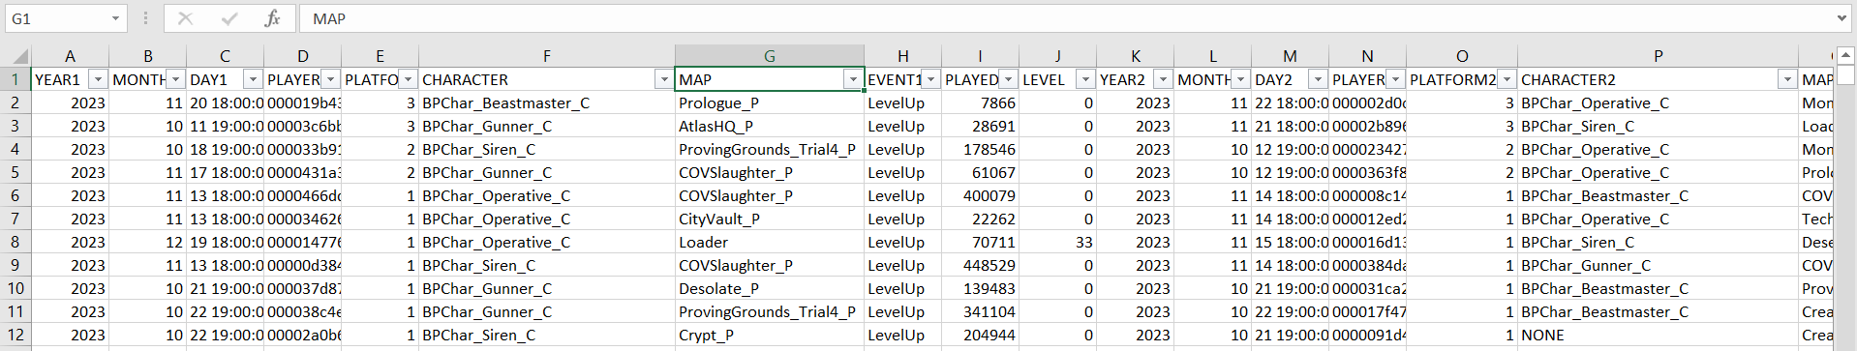
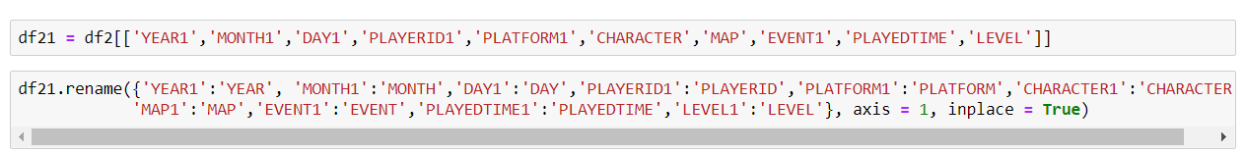
Cleaning in Excel
Brought corrupted rows into excel to work in real time with them
Split by commas and made a table with two tables’ worth of columns
Brought the data into python and split them into two tables, renaming for consistency

Slide 27
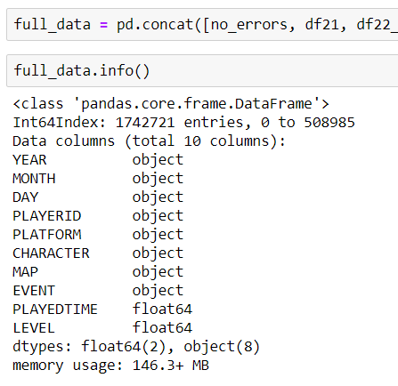
Bringing it together
Used Python to bring all of the data together
There were still some issues with the data. Some outliers and corrupted data, but only <1%
Examples: Data remaining in wrong row
Used RegEx and Type constraints to find them
Dropped them
Result: 1.7 mil clean rows of data

Slide 28
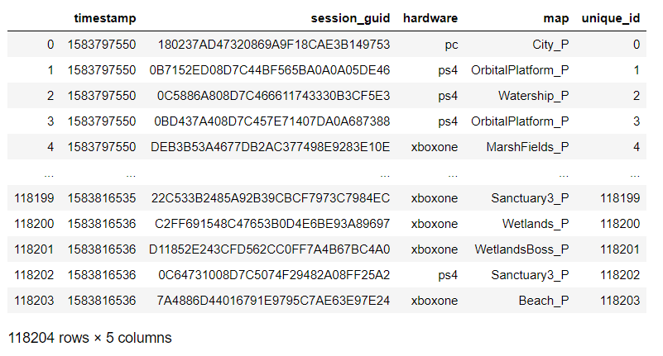
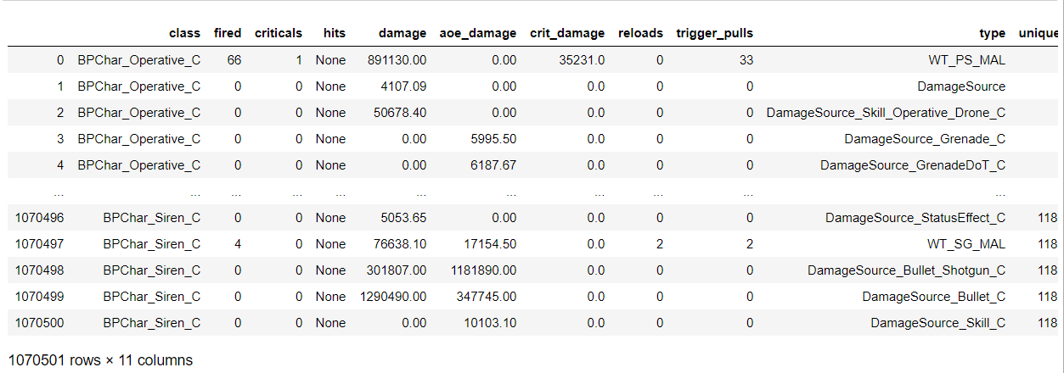
The JSON file
The JSON was a clean dataset, but needed to be worked on for Python and Jupyter Notebook use
Created two tables: one for ‘context’ and one for ‘weapons’
Assigned Unique Identifier for each JSON line
5 Hours worth of Data
~100,000 in context and 1,000,000 in weapons

Slide 29
Unique Players per Month
Peak single-day Unique Users just after launch at 5,000+
Has decreased to ~400 per day, 5 months after release
Peaks on the weekends

Slide 30
How Long are People Playing?
Players are likely to spend almost 3,000 minutes (50 hours) total in the world of borderlands
Most playing sessions are roughly an hour, but many extend to 2 or 3

Slide 31
Playtime by Month
Total Playtime heavily decreased by November, but increased again in January. Winter break?
There is not a large different in average session over time. So even if less people are playing, they are still spending just as long playing

Slide 32
Platform User Behaviors
The top two consoles (at this point I’m suspecting PS4 and Xbox), are played with similar habits
Console 4 (I’m suspecting the Stadia) increases in January because it was released then
Quickly decreases. Not working well?

Slide 33
Less PC Players… but they’re better?
There are only half the amount of PC players than PS4 and Xbox One players
They “get more done” though, and in less time
More experienced? Faster load times?

